Slide 1

School of Computer Science & IT Department of BCA
COMPUTER NETWORKS(23BCA3C02)
MODULE 4: NETWORK LAYER

Slide 2
Network Layer
Communication at the network layer is host-to-host (computer-to-computer); a computer somewhere in the world needs to communicate with another computer somewhere else in the world.
Usually, computers communicate through the Internet. The packet transmitted by the sending computer may pass through several LANs or WANs before reaching the destination computer.
For this level of communication, we need a global addressing scheme; we called this logical addressing or IP address.

Slide 3
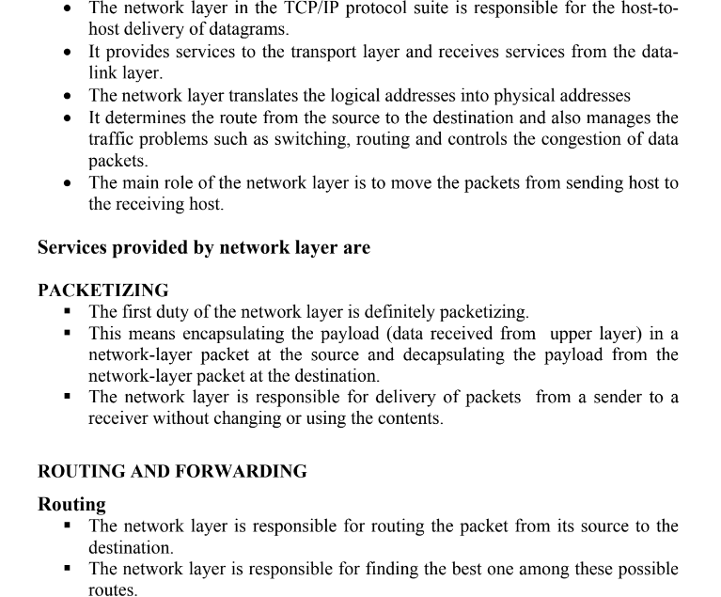
NETWORK LAYER SERVICES

Slide 4
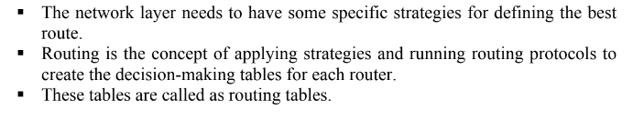
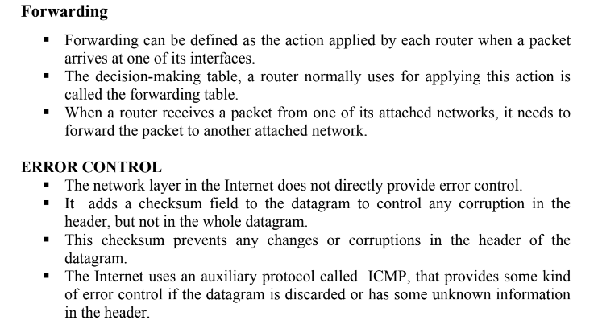

Slide 5
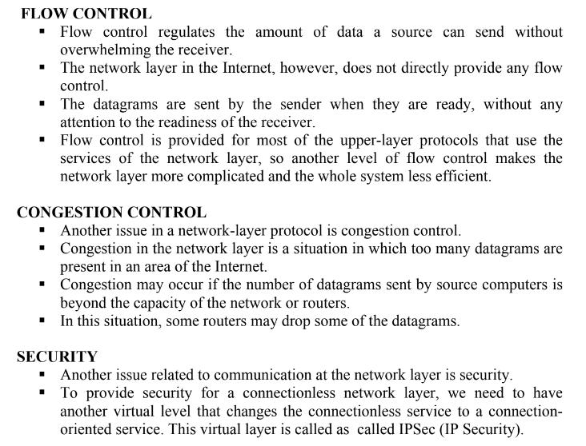

Slide 6
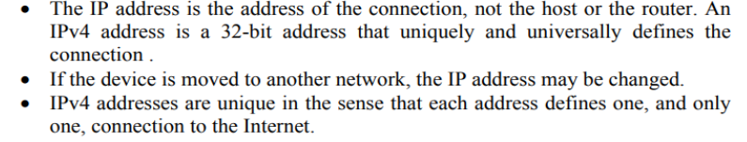
1.What is a Logical Address?
Logical address also referred to as IP (Internet Protocol) address is an universal addressing system. It is used in the Network layer. This address facilitates universal communication that are not dependent on the underlying physical networks. There are two types of IP addresses – IPv4 and IPv6.
The size of IPv4 is 32 bits. For example , 192 . 180 .210.1 where, 1 octant = 8 bits.
The size of IPv6 is 128 bits. For example ,
1C18 : 1B32 : C450 : 62A5 : 34DC : AE24 : 15BC : 6A5D where , 1 octant = 16 bits.
2.What is ipv4 and ipv6 addressing Formats?
The identifier used in the IP layer of the TCP/IP protocol suite to identify the connection of each device to the Internet is called the Internet address or IP address.
Internet Protocol version 4 (IPv4) is the fourth version in the development of the Internet Protocol (IP) and the first version of the protocol to be widely deployed.

Slide 7
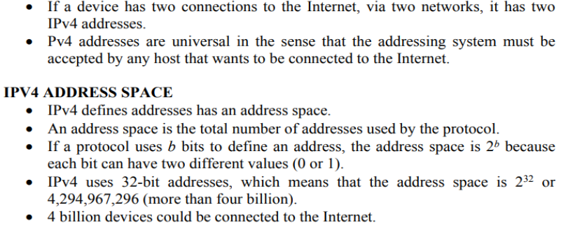
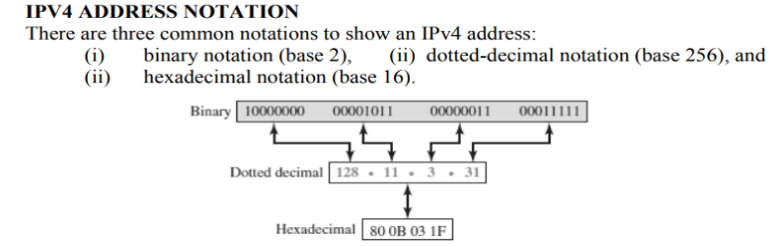

Slide 8
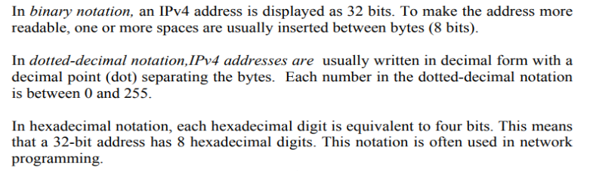

Slide 9
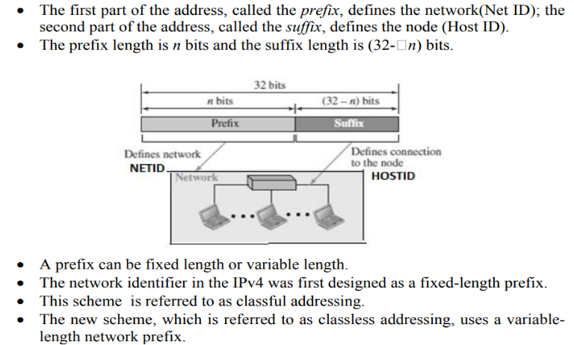

Slide 10
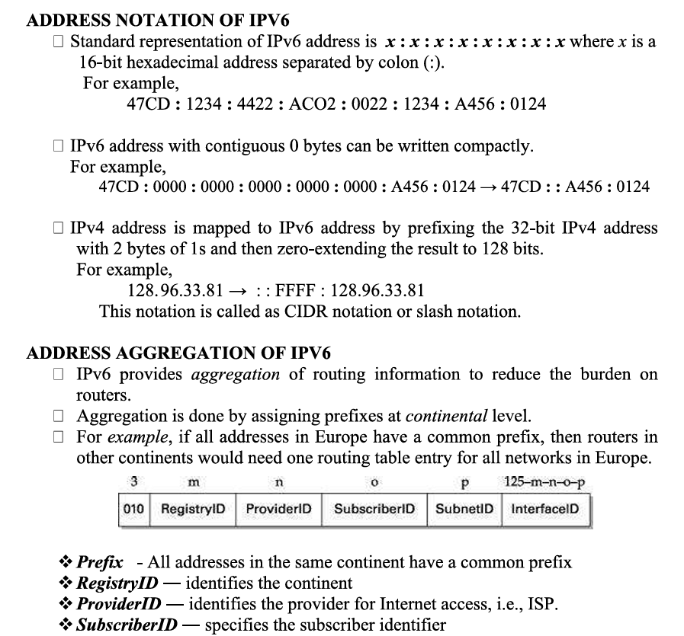
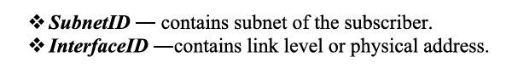

Slide 11
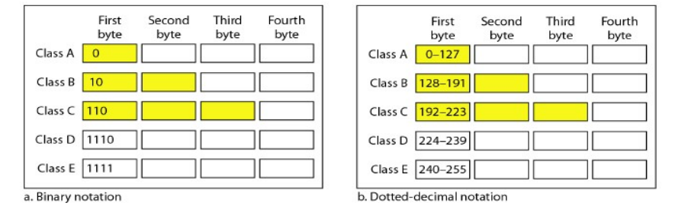
3.Explain about different categories of IPV4 addressing?(or explain about classful and classless addressing of IPV4?)
There are two types of IPv4 addressing schemes: 1. Classful Addressing 2. Classless Addressing (Classless Inter domain routing) Classful Addressing :
In classful addressing, the address space is divided into five classes: A, B, C, D, and E.
Each class occupies some part of the address space. We can find the class of an address when given the address in binary notation or dotted-decimal notation.
If the address is given in binary notation, the first few bits can immediately tell us the class of the address.
If the address is given in decimal-dotted notation, the first byte defines the class.
Finding the classes in binary and dotted-decimal notation

Slide 12
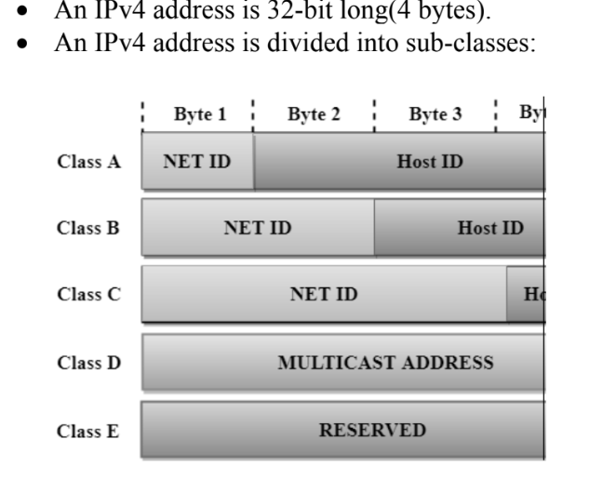

Slide 13
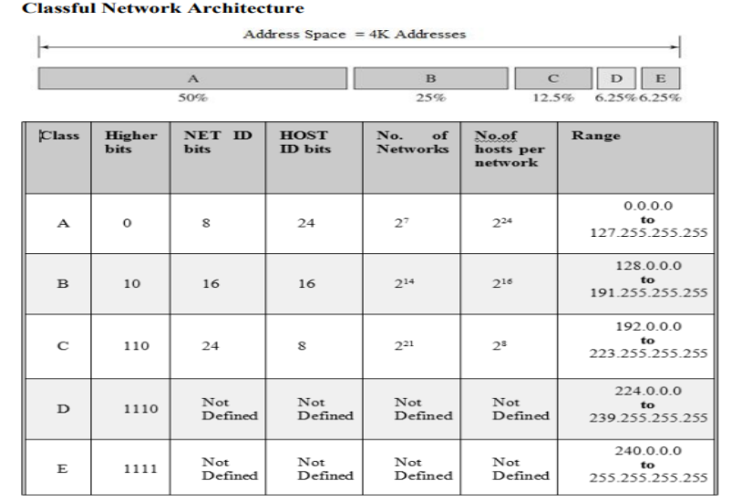

Slide 14
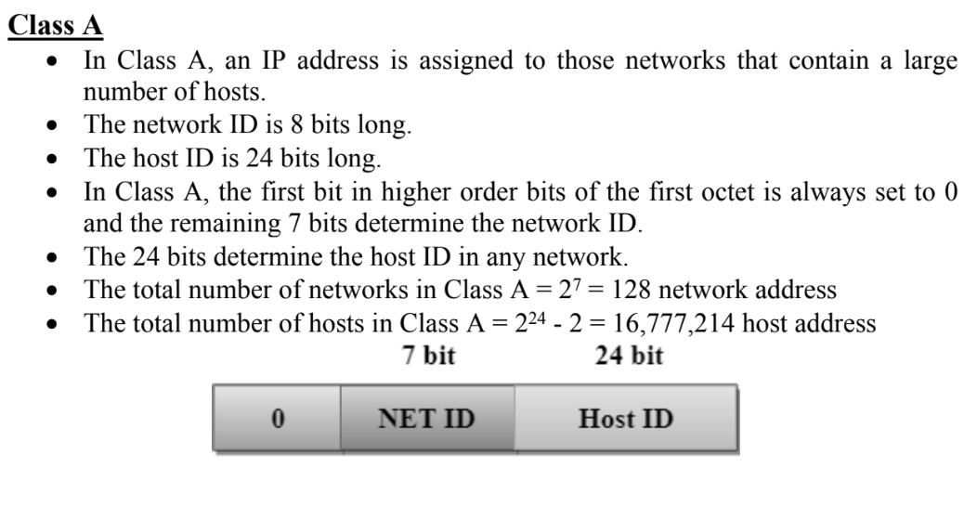

Slide 15
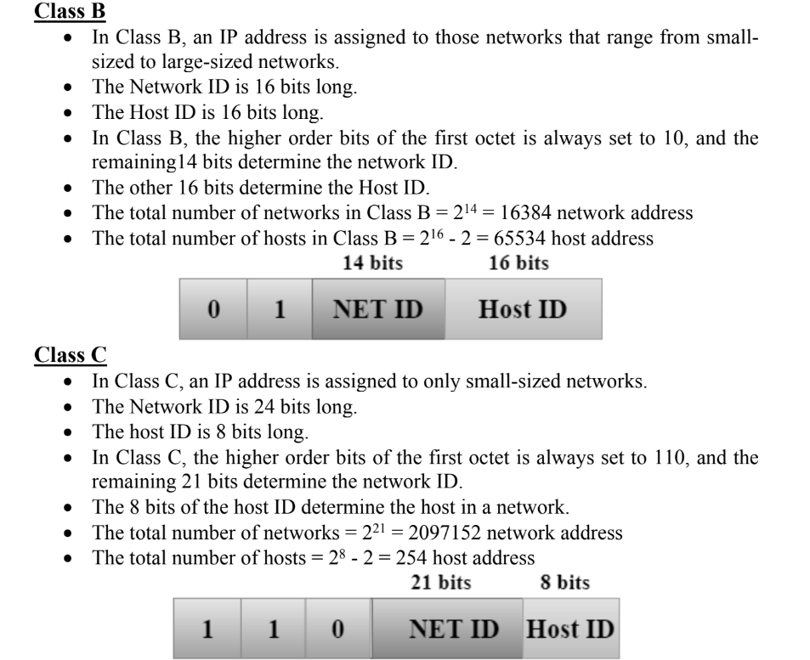

Slide 16
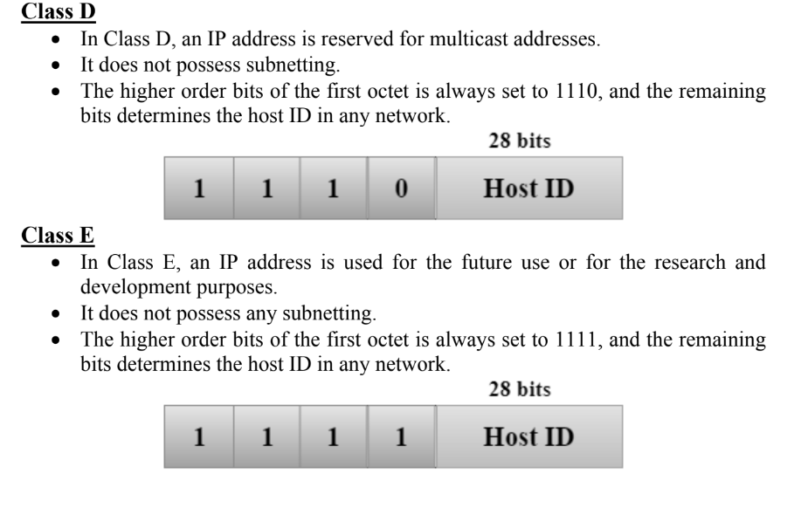

Slide 17
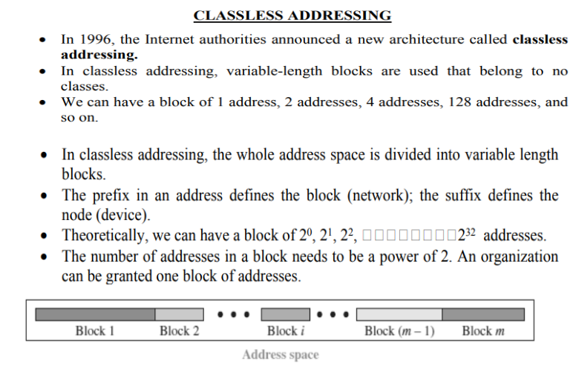

Slide 18
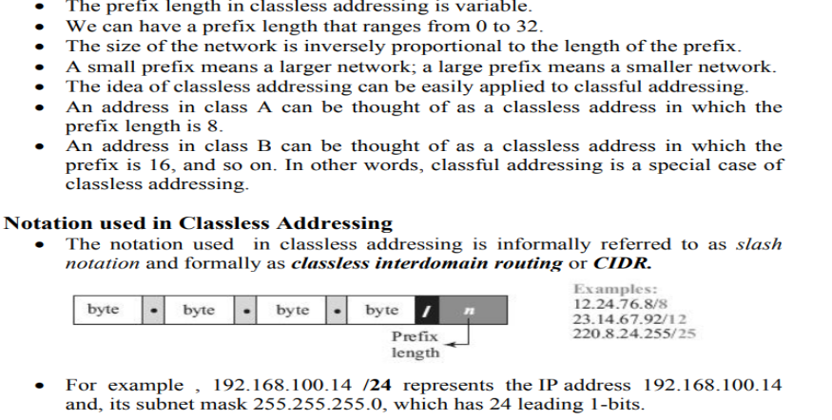
-------------------------------------------------------------------------------------------------------------------------------------------------------

Slide 19
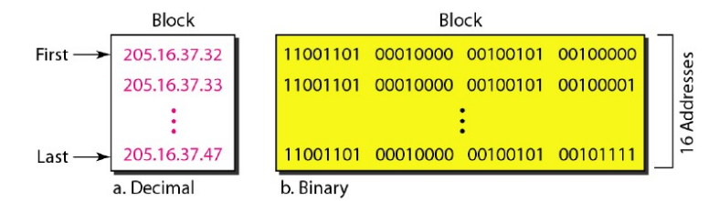
Example
Figure shows a block of addresses, in both binary and dotted-decimal notation, granted to a small business that needs 16 addresses. We can see that the restrictions are applied to this block. The addresses are contiguous.
The number of addresses is a power of 2 (16 = 24 ), and the first address is divisible by 16.
The first address, when converted to a decimal number, is 3,440,387,360, which when divided by 16 results in 215,024,210.

Slide 20
Mask : A better way to define a block of addresses is to select any address in the block and the mask.
A mask is a 32-bit number in which the n leftmost bits are 1s and the 32 - n rightmost bits are 0s.
However, in classless addressing the mask for a block can take any value from 0 to 32. It is very convenient to give just the value of n preceded by a slash (CIDR notation).
In 1Pv4 addressing, a block of addresses can be defined as x.y.z.t/n in which x.y.z.t defines one of the addresses and the /n defines the mask.
The address and the /n notation completely define the whole block (the first address, the last address, and the number of addresses).

Slide 21
PRACTICE PROBLEMS BASED ON CLASSLESS INTER DOMAIN ROUTING-
Example 1: A block of addresses is granted to a small organization. We know that one of the addresses is 205.16.37.39/28. What is the first and last addresses in the block?
Solution : The binary representation of the given address is 11001101 00010000 00100101 00100111.
If we set 32 - 28 rightmost bits to 0, we get 11001101 0001000 00100101 0010000 or 205.16.37.32.
To find the last address for the block :
The binary representation of the given address is 11001101 00010000 00100101 00100111.
If we set 32 - 28 rightmost bits to 1, we get 11001101 00010000 00100101 0010 1111 or 205.16.37.47.

Slide 22
Problem-02:
Given the CIDR representation 20.10.30.35 / 27. Find the range of IP Addresses in the CIDR block.
Solution-
Given CIDR representation is 20.10.30.35 / 27.
It suggests-
27 bits are used for the identification of network.
Remaining 5 bits are used for the identification of hosts in the network.
Given CIDR IP Address may be represented as-
00010100.00001010.00011110.00100011 / 27So,
First IP Address = 00010100.00001010.00011110.00100000 = 20.10.30.32
Last IP Address = 00010100.00001010.00011110.00111111 = 20.10.30.63
Thus, Range of IP Addresses = [ 20.10.30.32 , 20.10.30.63]

Slide 23
Problem-03:
Given the CIDR representation 100.1.2.35 / 20. Find the range of IP Addresses in the CIDR block.
Solution-
Given CIDR representation is 100.1.2.35 / 20.
It suggests-
20 bits are used for the identification of network.
Remaining 12 bits are used for the identification of hosts in the network.
Given CIDR IP Address may be represented as-
01100100.00000001.00000010.00100011 / 20
So,
First IP Address = 01100100.00000001.00000000.00000000 = 100.1.0.0
Last IP Address = 01100100.00000001.00001111.11111111 = 100.1.15.255
Thus, Range of IP Addresses = [ 100.1.0.0 , 100.1.15.255]

Slide 24
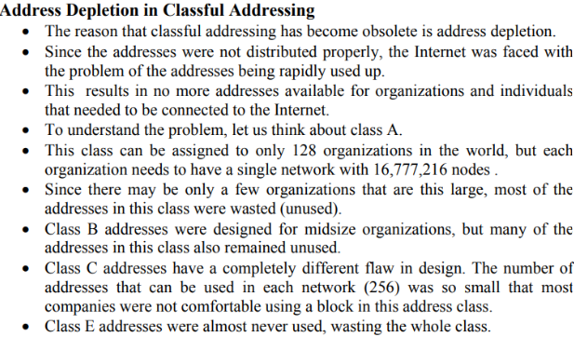
4. Write about the problems with classful addressing?

Slide 25
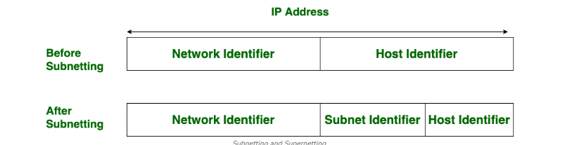
5. How the problems in address depletion of classful addressing are addressed?
To alleviate address depletion, two strategies were proposed and implemented: i) Subnetting and (ii) Supernetting.
Subnetting is the procedure to divide the network into sub-networks or small networks, these smaller networks are known as subnets. The subnet is also defined as an internal address made up of a combination of a small network and host segments. In a subnet, a few bits from the host portion are used to design small-sized subnetworks from the original network. In subnetting, network bits are converted into host bits.
Supernetting is the procedure to combine small networks into larger spaces. In subnetting, Network addresses’ bits are increased. on the other hand, in supernetting, Host addresses’ bits are increased. Subnetting is implemented via Variable-length subnet masking, While super netting is implemented via Classless interdomain routing.

Slide 26
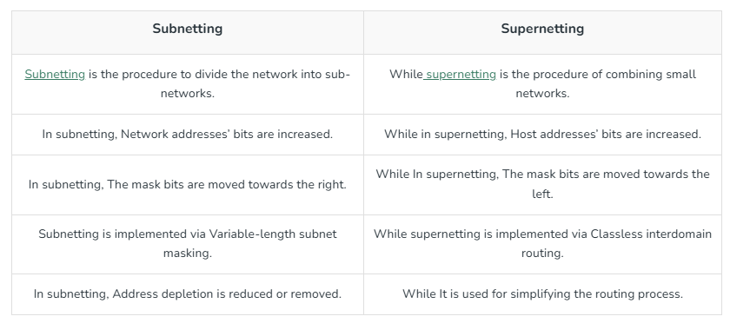
6.Difference between Subnetting and Supernetting?

Slide 27
7. Explain FLSM Subnetting and VLSM Subnetting ?
There are two types of Subnetting: FLSM and VLSM.
In FLSM, all subnets have an equal number of host addresses and use the same subnet mask.
In VLSM, subnets have a flexible number of host addresses. They use a subnet mask based on the number of hosts.
FLSM stands for Fixed Length Subnet Mask. In it, we break the default IP subnet into the same-sized subnets.
For example, if the default subnet has 12 IP addresses, we can break it into three equal-sized subnets having 4 IP addresses in each.
VLSM stands for Variable Length Subnet Mask. In it, we break the default IP subnet into subnets having various sizes.
For example, if the default subnet has 12 IP addresses, we can break it into two subnets where the first subnet has 8 IP addresses and the second subnet has 4 IP addresses.

Slide 28
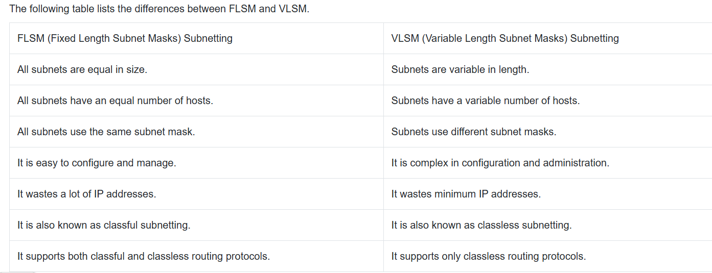
The following table lists the differences between FLSM and VLSM.

Slide 29
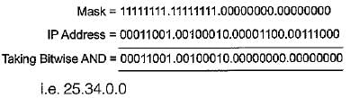
Problem on subnet masking :
In a class A subnet, we know the IP address of one of the hosts and the mask as given below:
IP address = 25.34.12.56 Mask = 255.255.0.0 What is the first address (network address)?

Slide 30
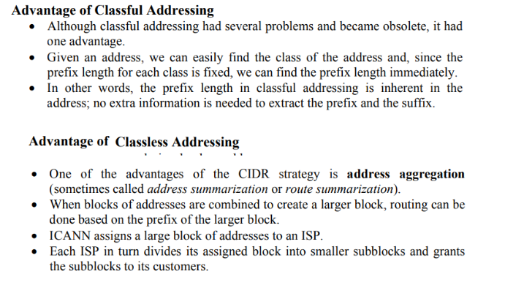
8. Write about the Advantage of Classful Addressing and classless addressing?

Slide 31
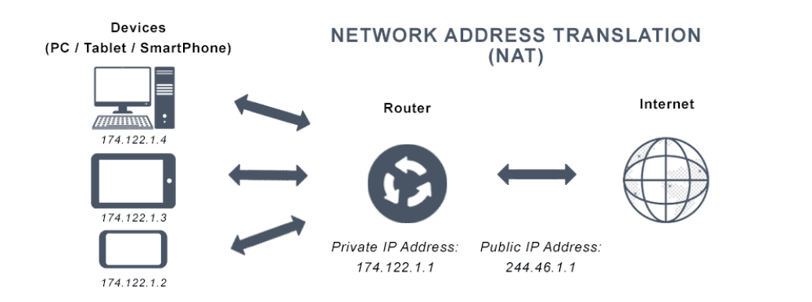
9.What Is Network Address Translation?
Network Address Translation (NAT) is a method used by network devices, such as routers, to translate the IP addresses of devices in a private network to a single IP address in order to communicate with the internet. This allows multiple devices to share a single public IP address and access the internet through a single connection.
You can commonly use NAT in home networks, allowing multiple devices to connect to the internet using a single internet connection and a public IP address. It is also used in more extensive networks, such as corporate or academic networks, to conserve the number of public IP addresses needed and provide an additional security layer.

Slide 32
10. What are the Addresses of NAT ?
In a network that uses Network Address Translation, there are two types of IP addresses:
Private IP addresses (inside address)
Public IP addresses (outside address)
Private IP addresses: Devices in the private network use these addresses in order to communicate with each other. These addresses are not unique and are not reachable from the internet. Private IP addresses are assigned from a range of reserved addresses, such as 192.168.0.0/16 or 10.0.0.0/8.
Public IP addresses: Devices on the internet use these addresses in order to communicate with devices in the private network. These addresses are unique and are assigned by the Internet Service Provider (ISP). A device in the private network can be reached from the internet using its public IP address.
The Network Address Translation device translates the private IP addresses and port numbers of the devices in the private network to public IP addresses and unique port numbers when they communicate with the internet. This allows the devices to share a single public IP address and access the internet through a single connection.

Slide 33
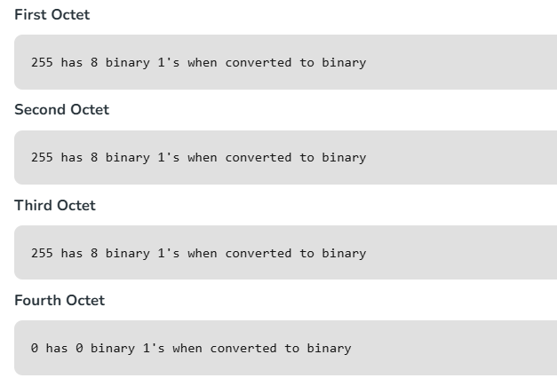
11.What is Classless Inter-Domain Routing (CIDR)?
CIDR or Class Inter-Domain Routing was introduced in 1993 to replace classful addressing. Classless Inter-Domain Routing (CIDR) is a method for efficiently allocating IP addresses and routing Internet Protocol (IP) packets. Unlike classful addressing, which divides IP addresses into fixed classes (A, B, C, etc.), CIDR allows for variable-length subnet masks (VLSM). This means that networks can be divided into smaller, more flexible subnets according to their specific needs, rather than being constrained by predefined class boundaries.
CIDR Notation
In CIDR subnet masks are denoted by /X. For example a subnet of 255.255.255.0 would be denoted by /24. To work a subnet mask in CIDR, we have to first convert each octet into its respective binary value. For example, if the subnet is of 255.255.255.0. then :

Slide 34
Therefore, in total there are 24 binary 1’s, so the subnet mask is /24.
While creating a network in CIDR, a person has to make sure that the masks are contiguous, i.e. a subnet mask like 10111111.X.X.X can’t exist.
With CIDR, we can create Variable Length Subnet Masks, leading to less wastage of IP addresses.
It is not necessary that the divider between the network and the host portions is at an octet boundary.
For example, in CIDR a subnet mask like 255.224.0.0 or 11111111.11100000.00000000.00000000 can exist.

Slide 35
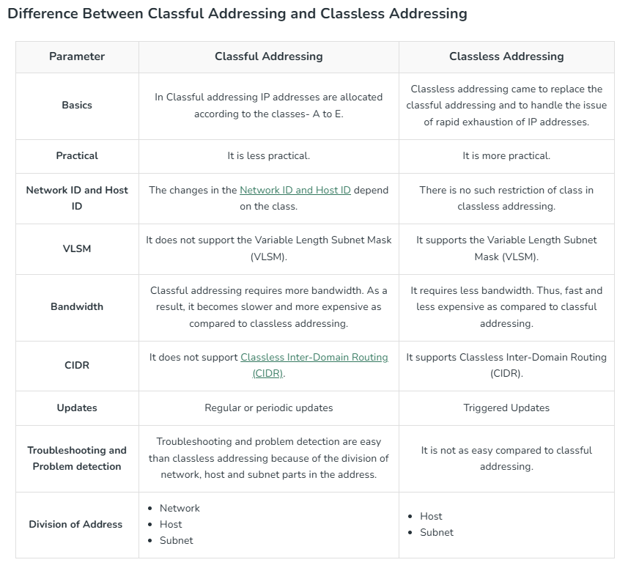
11.Differentiate Between Classful Addressing and Classless Addressing ?

Slide 36
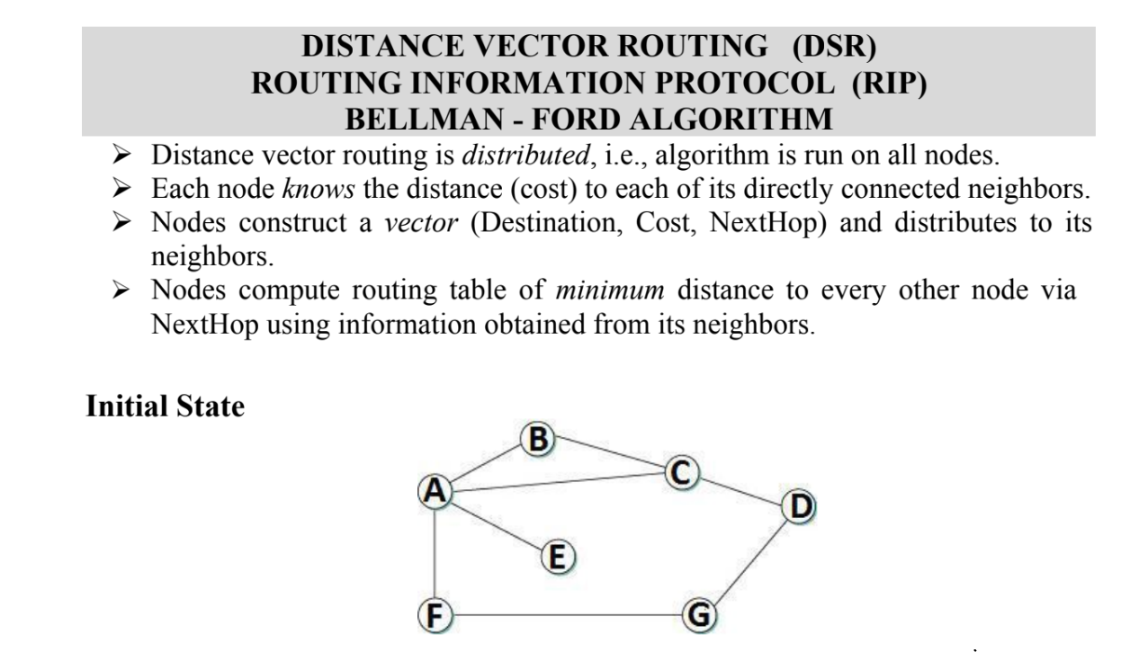
12.Explain Distance vector routing Algorithm with an example?

Slide 37
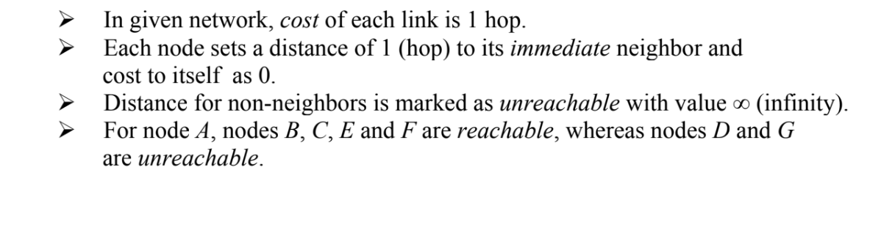
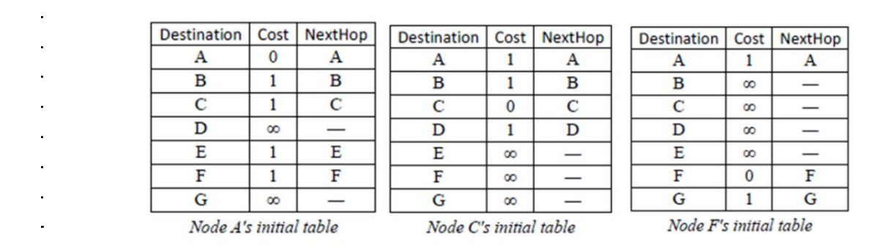

Slide 38
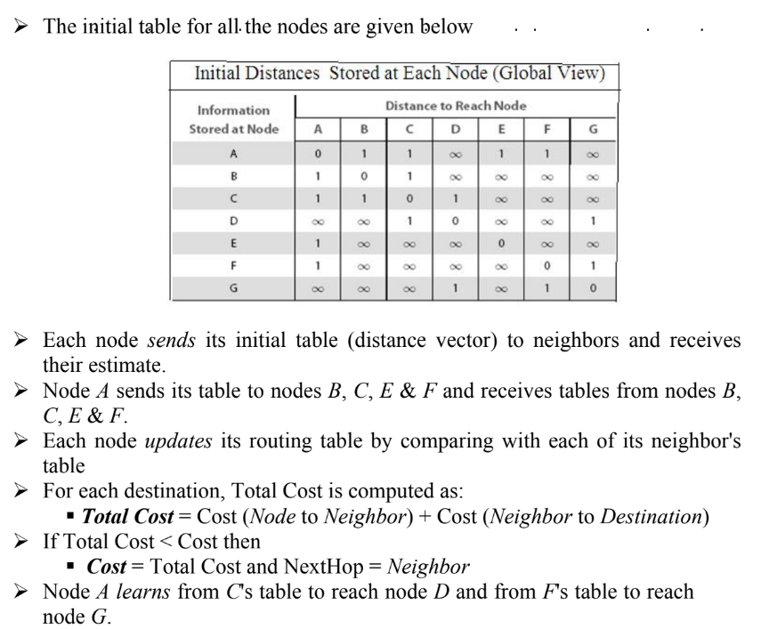

Slide 39
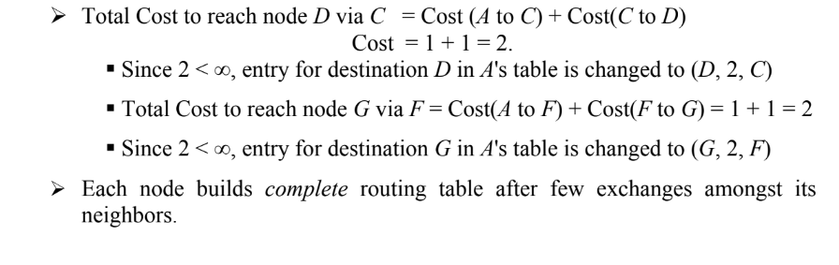

Slide 40
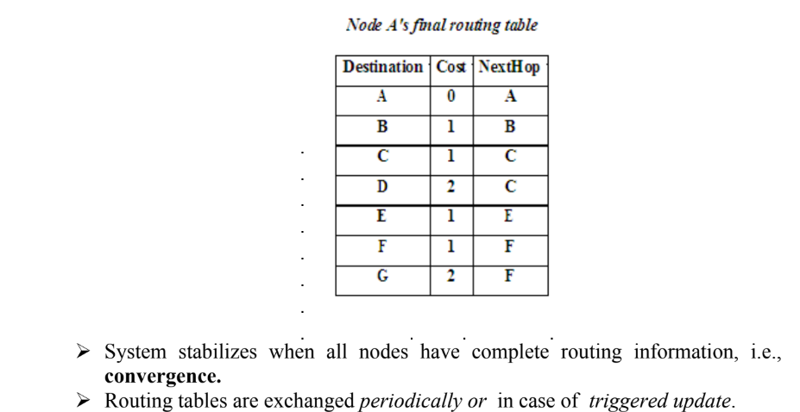

Slide 41
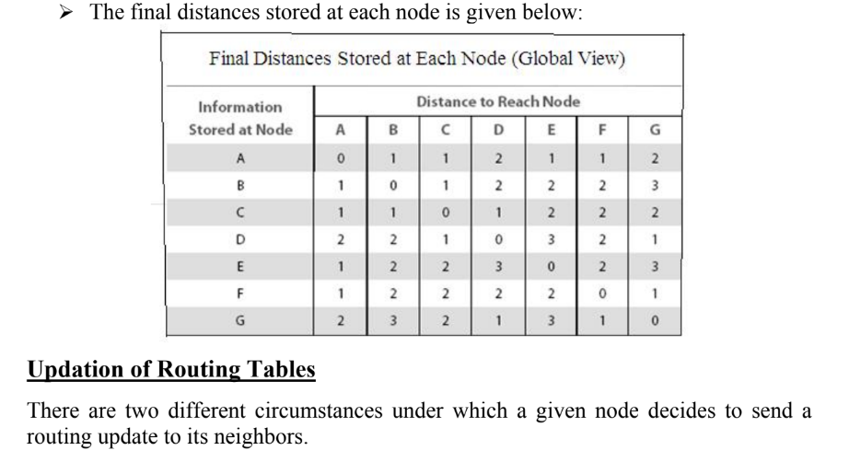

Slide 42
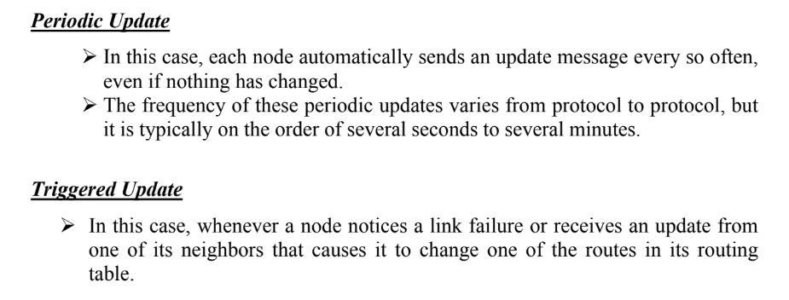
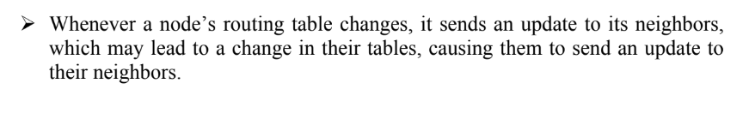

Slide 43
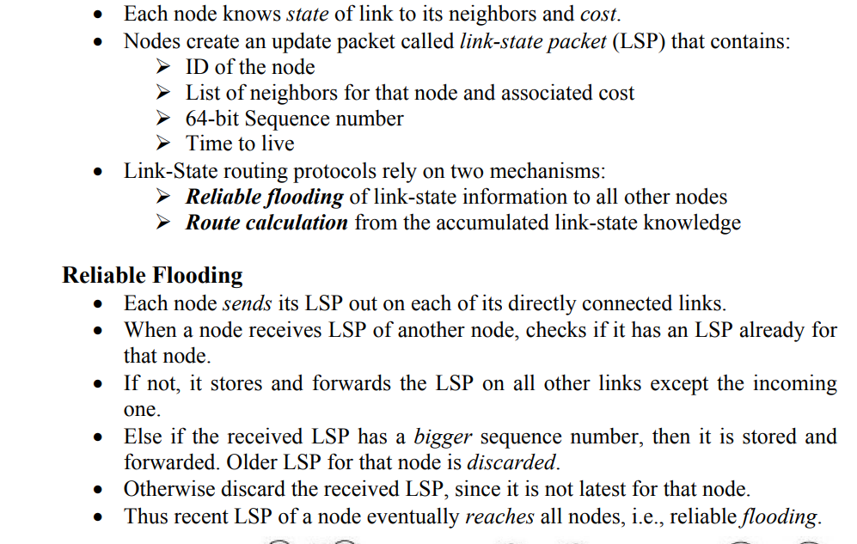
13. Explain Link state routing algorithm?

Slide 44
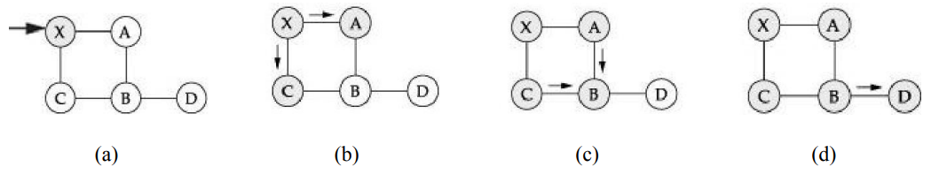
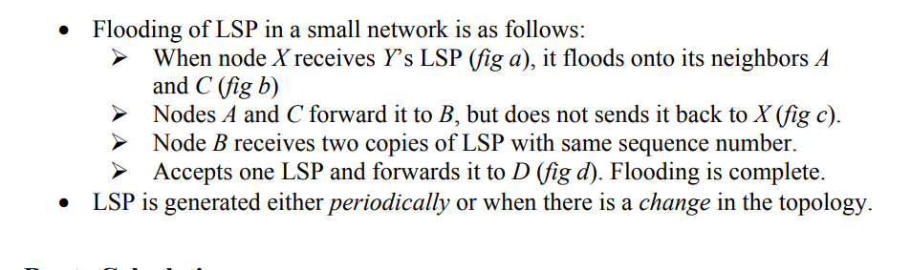

Slide 45
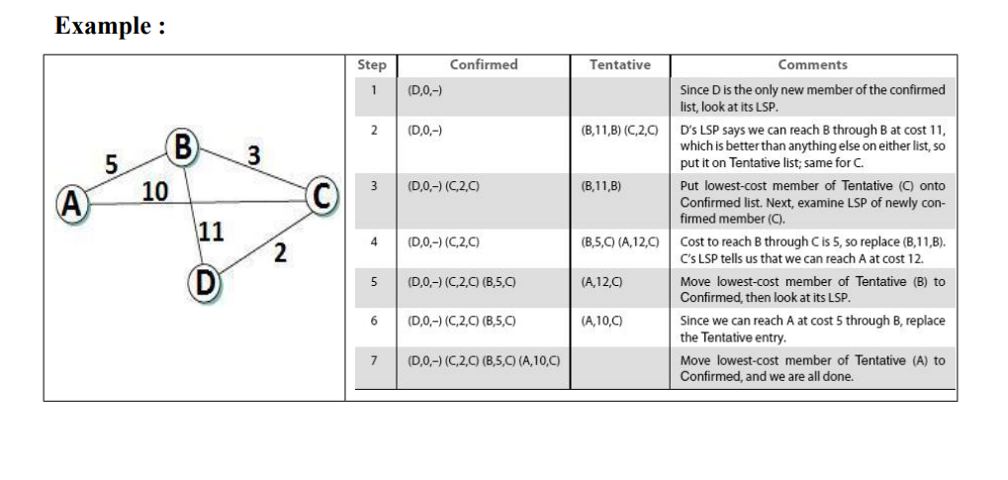

Slide 46
14. Write about path vector routing algorithm?
In path-vector routing, the path from a source to all destinations is also determined by the best spanning tree.
The best spanning tree, however, is not the least-cost tree; it is the tree determined by the source when it imposes its own policy.
If there is more than one route to a destination, the source can choose the route that meets its policy best.
A source may apply several policies at the same time.

Slide 47
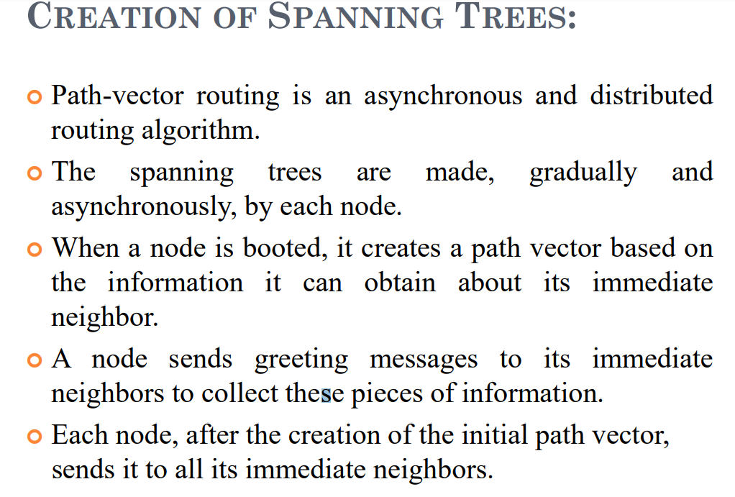

Slide 48
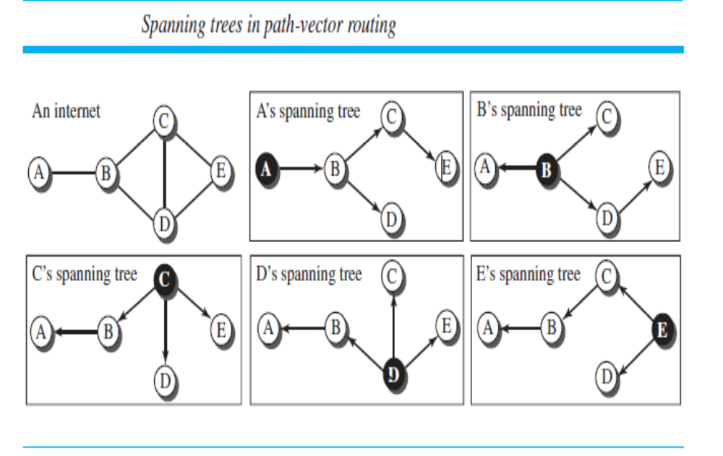

Slide 49
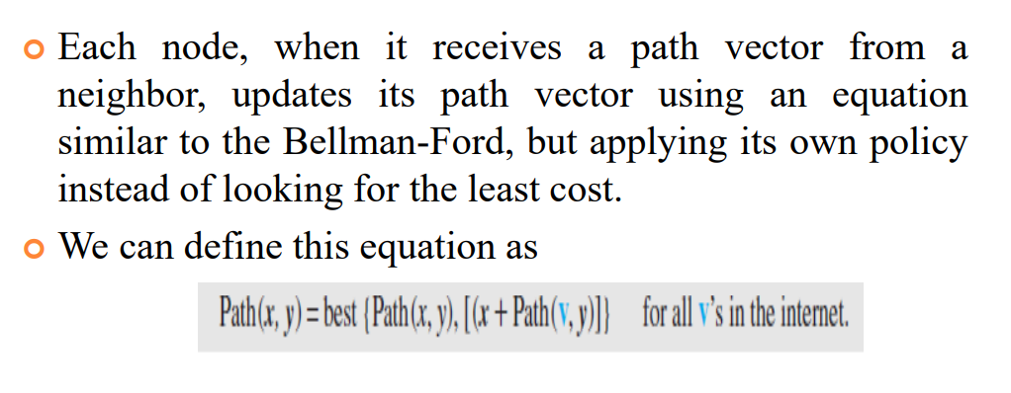
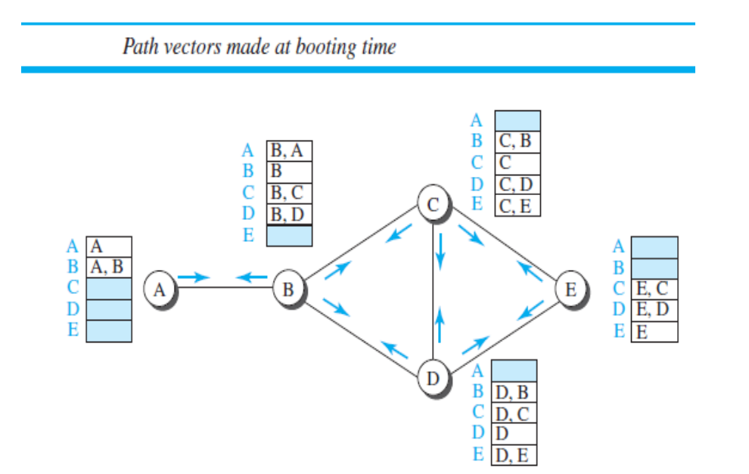

Slide 50
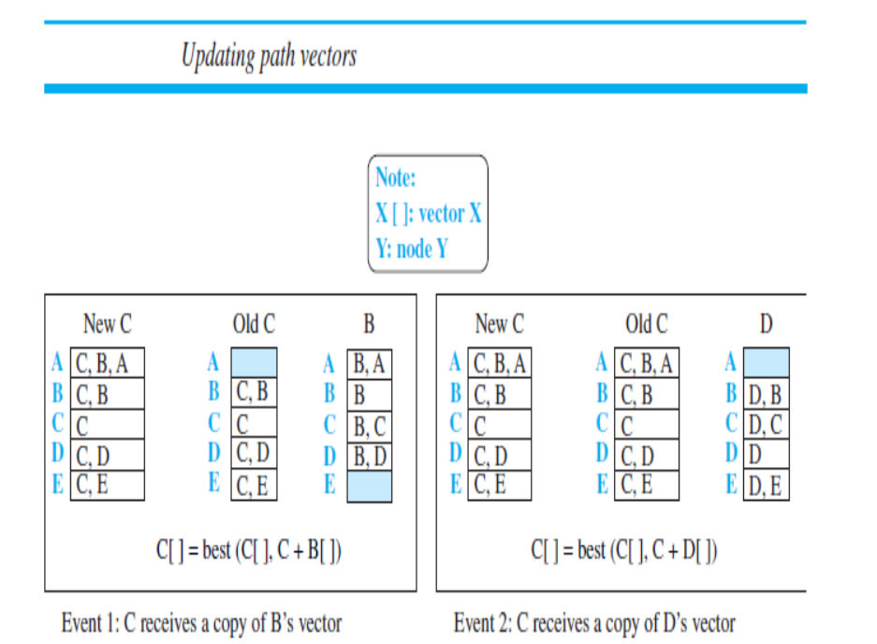

Slide 51
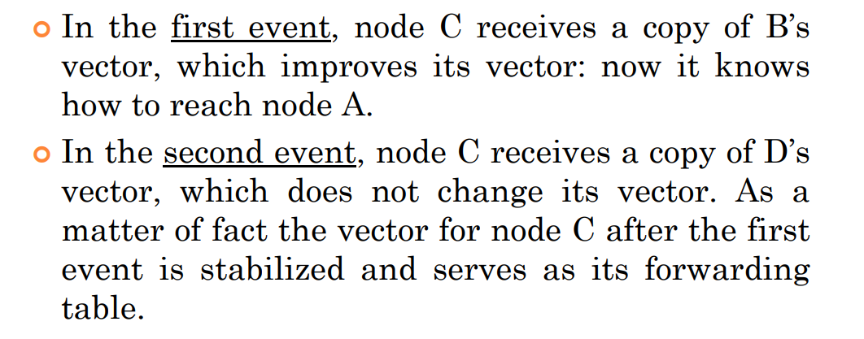

Slide 52
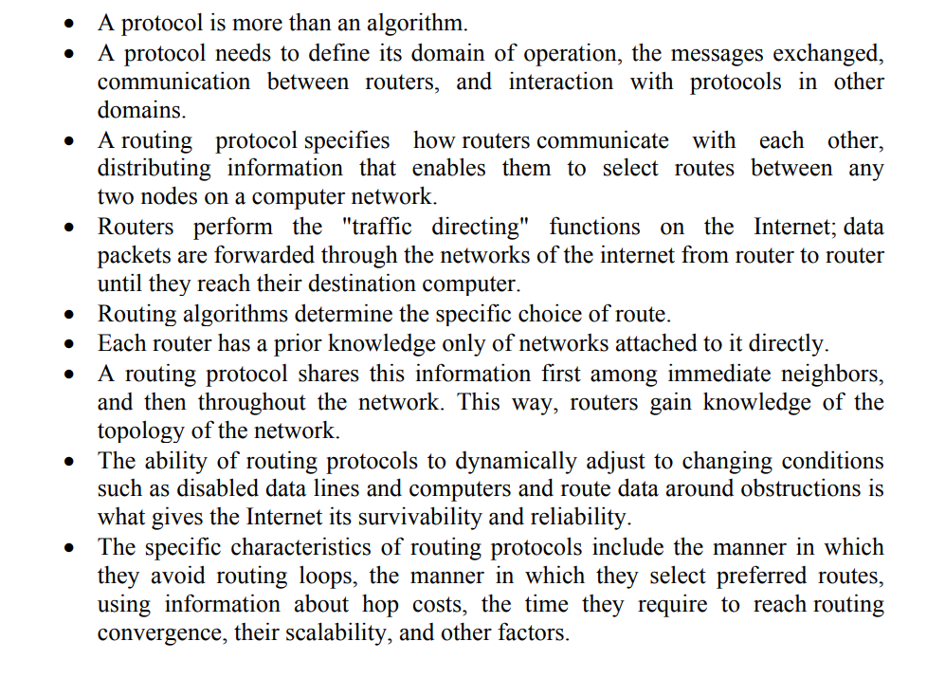
15. Write about various unicast routing protocols?

Slide 53
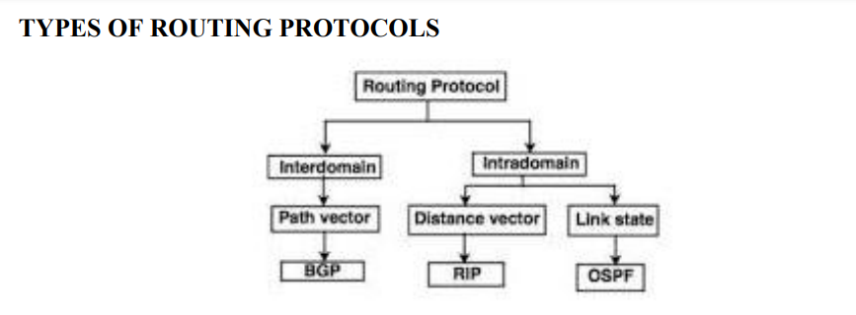
Two types of Routing Protocols are used in the Internet:
Intradomain routing
Routing within a single autonomous system
Routing Information Protocol (RIP) - based on the distance-vector algorithm
Open Shortest Path First (OSPF) - based on the link-state algorithm
2) Interdomain routing
Routing between autonomous systems.
Border Gateway Protocol (BGP) - based on the path-vector algorithm

Slide 54

1.ROUTING INFORMATION PROTOCOL (RIP) :
RIP is an intra-domain routing protocol based on distance-vector algorithm.
Each router updates cost and next hop for each network number.
Infinity is defined as 16, i.e., any route cannot have more than 15 hops. Therefore RIP can be implemented on small-sized networks only.
Advertisements are sent every 30 seconds or in case of triggered update.

Slide 55


Slide 56


Slide 57


Slide 58


Slide 59


Slide 60


Slide 61


Slide 62

16.Classify the structure of a packet header
IPv4
IPv6

Slide 63


Slide 64


Slide 65

17.Explain the features of Ipv6 ?

